Slide 1
MADADGAR ANDROID APPLICATION
FARDEEN MIRZA CIIT/FA17-BCS-019/VHR
HIRA IMTIAZ CIIT/FA17-BCS-027/VHR

Slide 2
Project introduction
MADADGAR app is interactive and innovative mobile (Android) based application. This project focuses on a security system that is designed to solely to serve the purpose of providing security to women so that they never feel helpless while facing such social challenges. Generally you can active this service by clicking on SOS button, after pressing the button it will open a new window and send SMS to those contacts which you saved in app and SMS contain your message and your current location. When you will signup in application you have to give correct data( like email, if you gave your Gmail then the app will verify your email by sending confirmation code to your Gmail account ) otherwise you cannot signup in the application.

Slide 3
Scope of project
The basic aim of the system is to develop a low cost solution for GPS based women tracking system (women safety system). The main objective of the system is to track the current location of the person which has an android enabled mobile by extracting the longitude and latitude of that target person. The basic function of this project is to ask help from others when you are in danger situation. It is online system. This application helps efficiently increase the security and safety of woman.

Slide 4
Feature of our project
Features of our project are listed given below:
Sign up with Email verification
SOS button ( when we will press SOS button then it will send a SMS with a specific message and your current location to your saviors )
For location, we use GOOGLE Maps services so that we can get exact location of the user
You can add , delete and update your saviors data
Safety tips
Emergency helpline contacts
Voice recorder

Slide 5
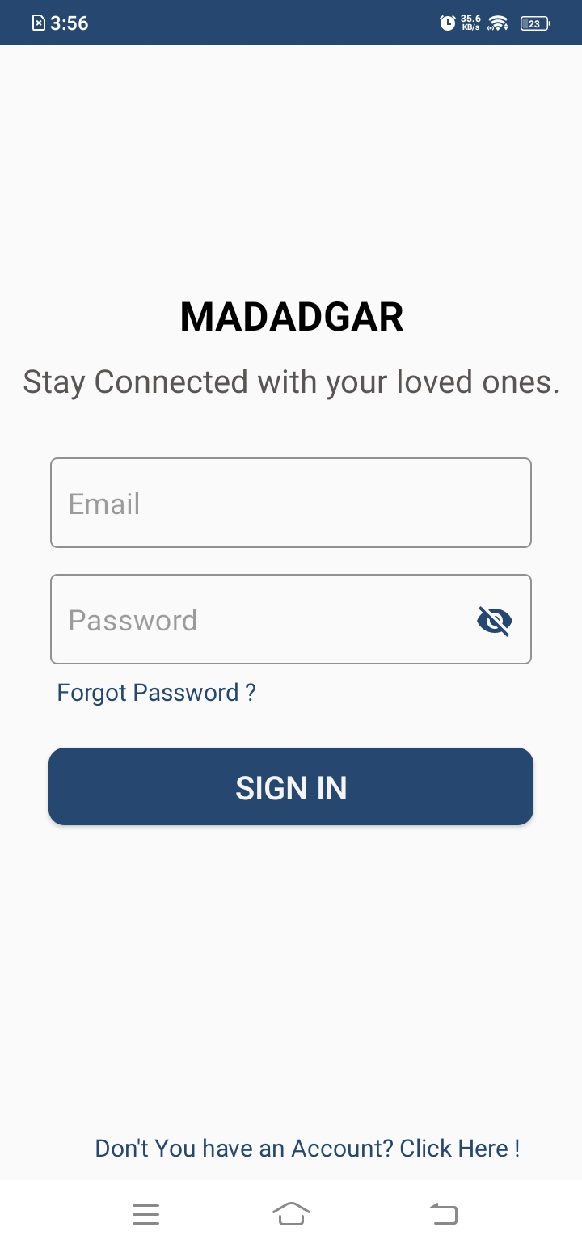
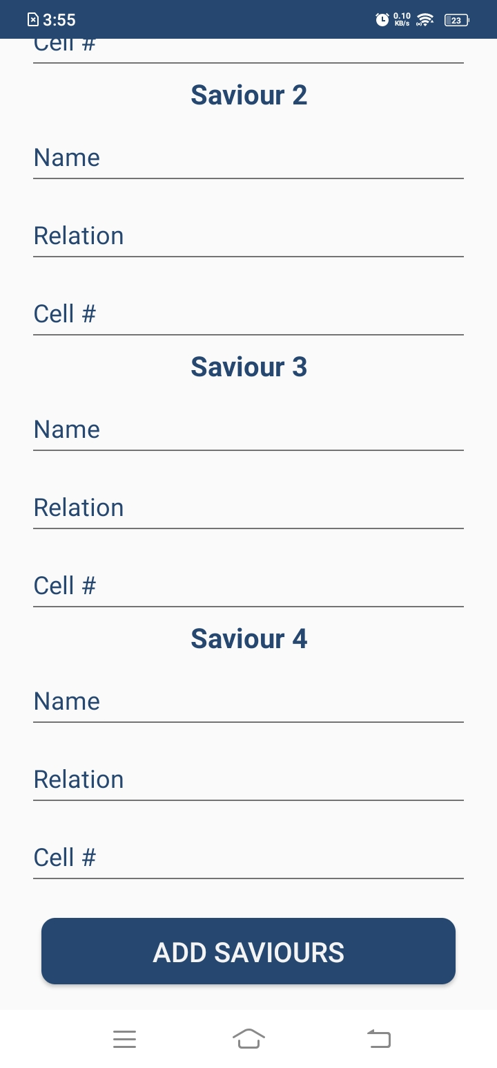
User interface

Slide 6
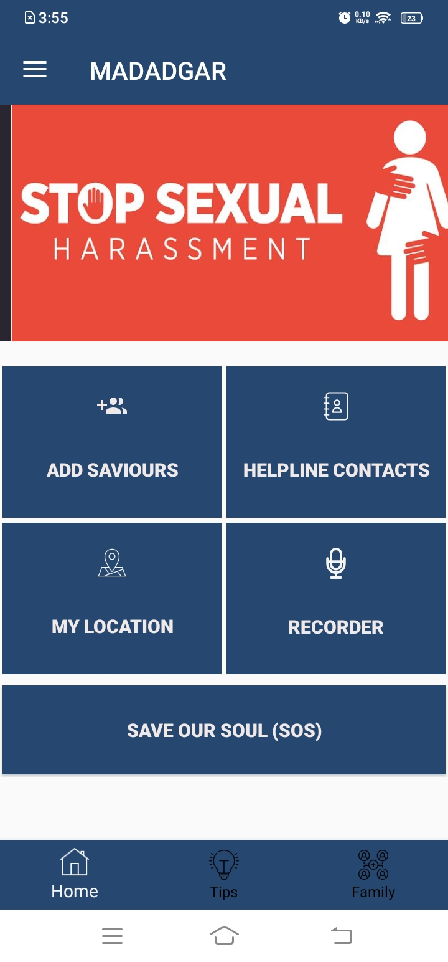
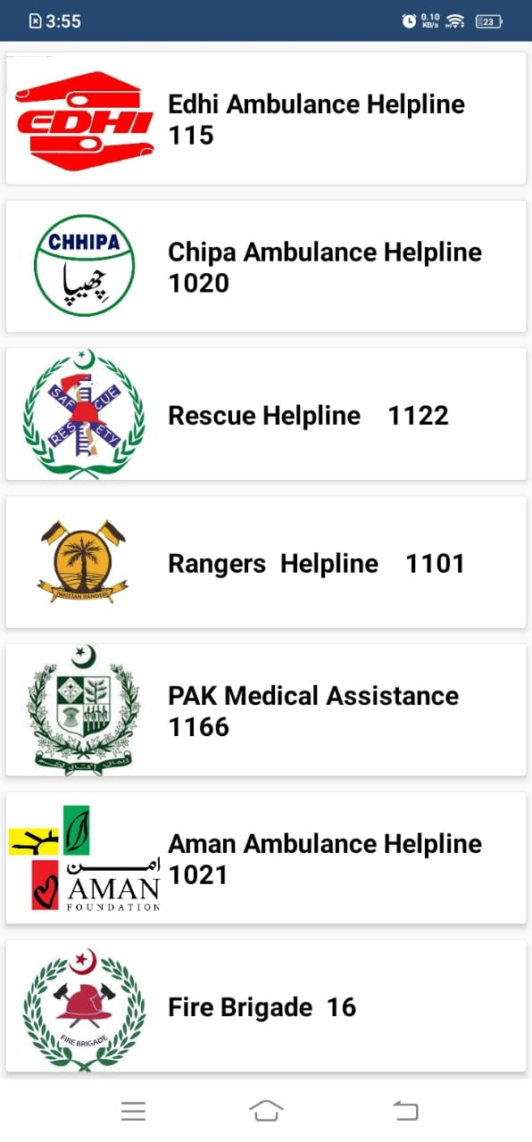

Slide 7
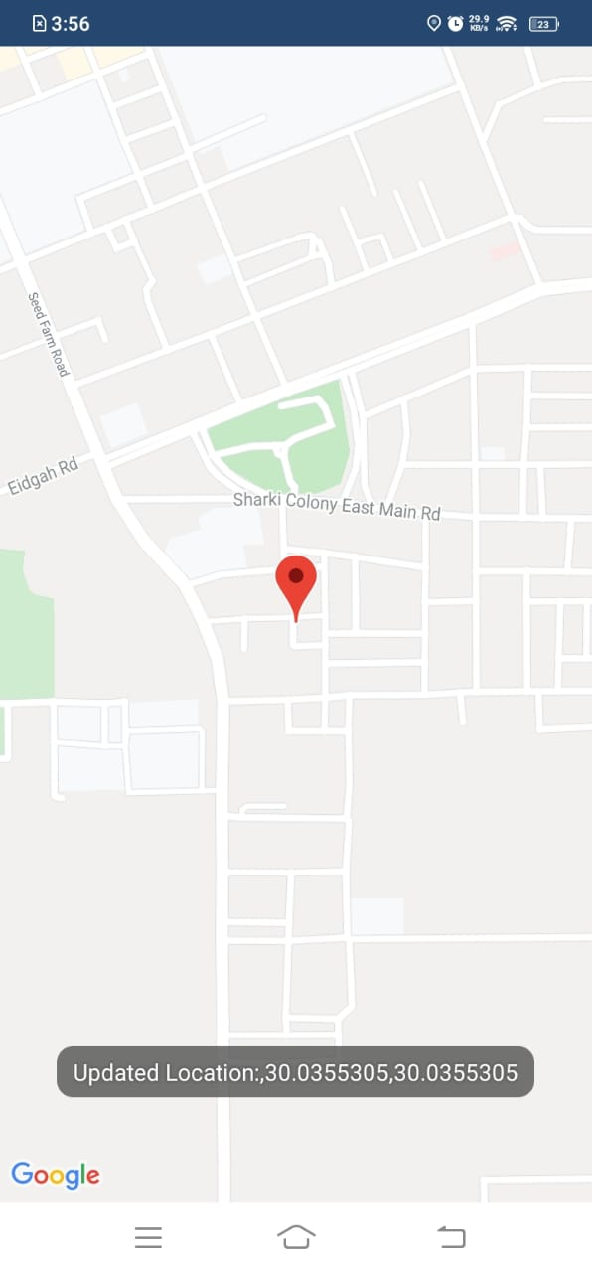
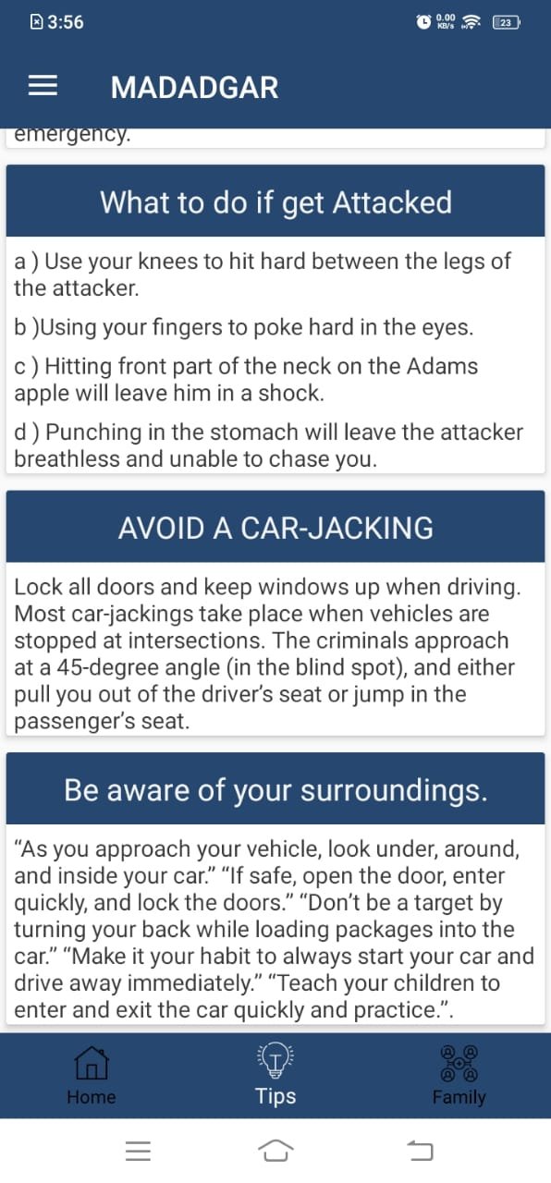

Slide 8
Algorithm
⦁ Start App.
⦁ Register for Account.
⦁ Login to app.
⦁ Select the option SOS (Emergency Distress Signal.)
⦁ The help Signal sent to all guardians and security around women with your GPS location.
⦁ Select the Emergency contacts to call (Police Ambulance and fire brigade etc.).
⦁ Send help message to your nearby guardians, family members, friends and security.
⦁ Close App.

Slide 9
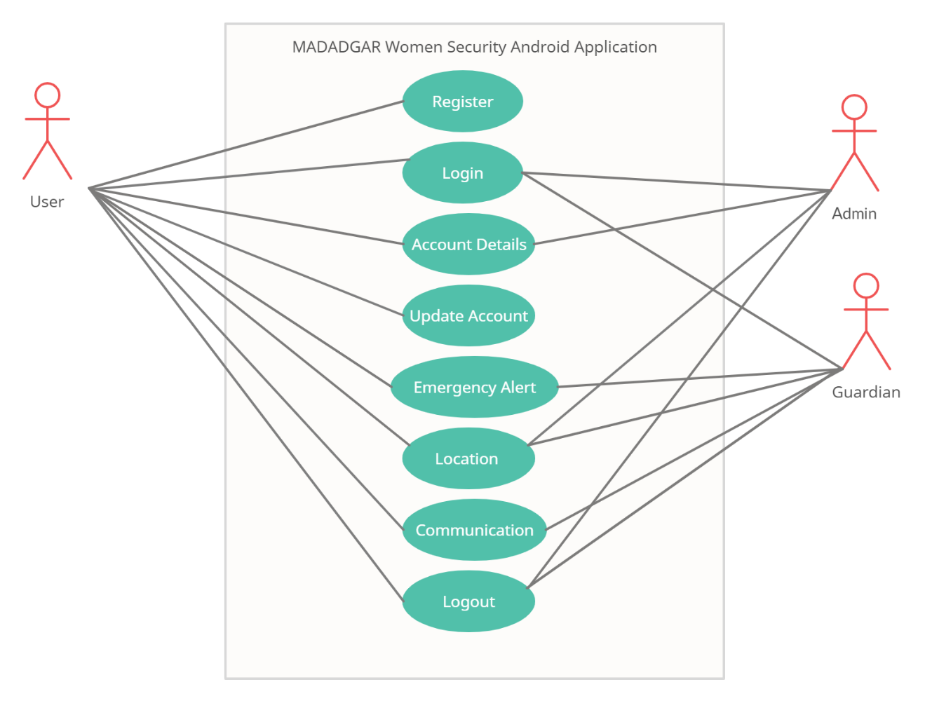
Use Case

Slide 10
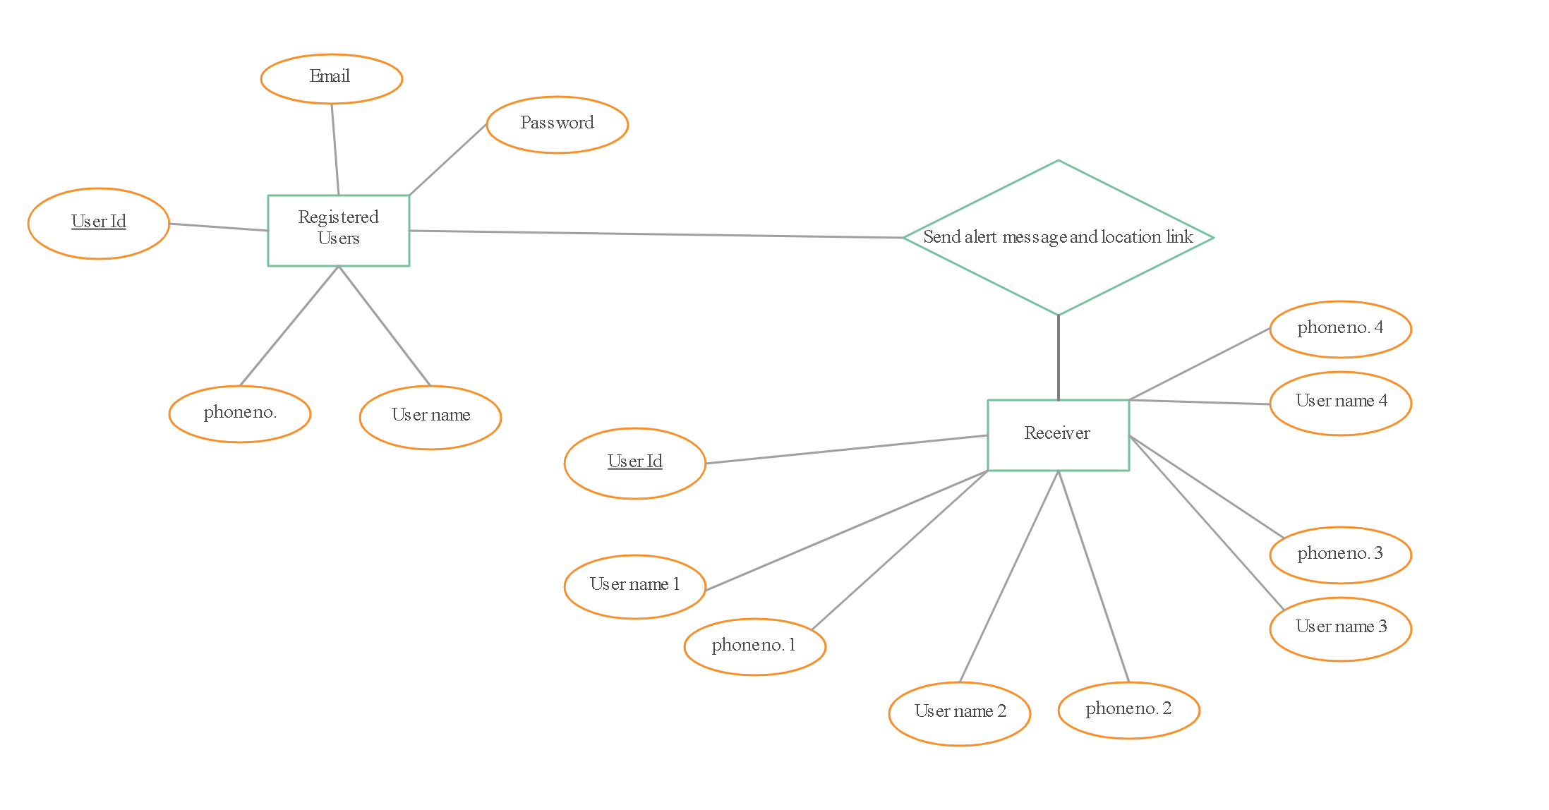
ERD

Slide 11
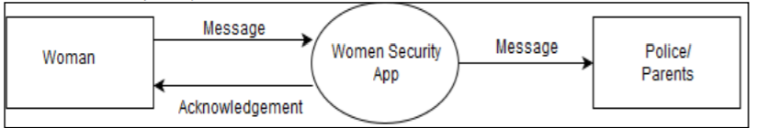
DFD

Slide 12
Future plan
In future, we will also build our application in IOS Appstore system and we will also add hidden cameras and location of other users on map. We will also add a feature like when we shake our phone then on phone screen a confirmation message will appear and we will directly send the SMS to saved contacts without wasting time.

Slide 13
ThankYou

